Slide 1
Web Search & Link Analysis

Slide 2
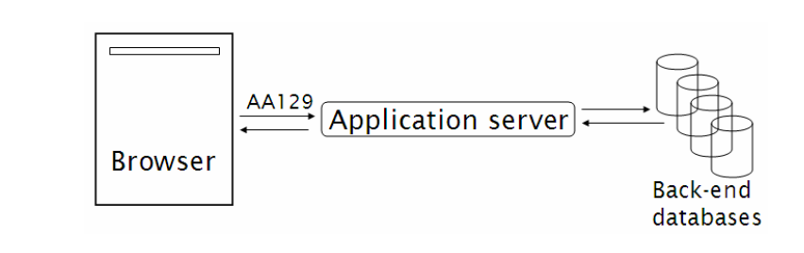
Web Search & Crawling
The analysis of hyperlinks and the graph structure of the Web has been instrumental in the development of web search.
decentralized content publishing: Web page authors created content in dozens of (natural) languages and thousands of dialects, thus demanding many different forms of stemming and other linguistic operations.
“how big is the Web?
Dynamic vs Static Pages

Slide 3
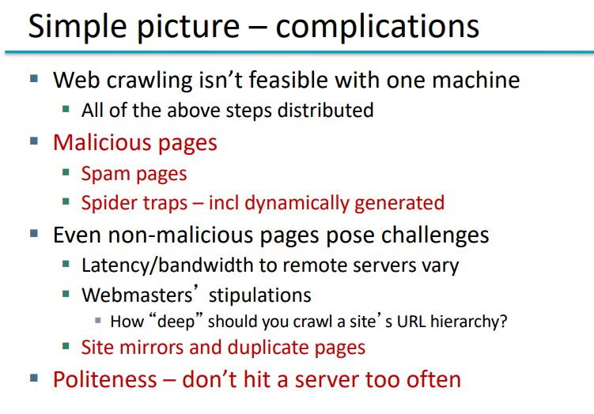

Slide 4
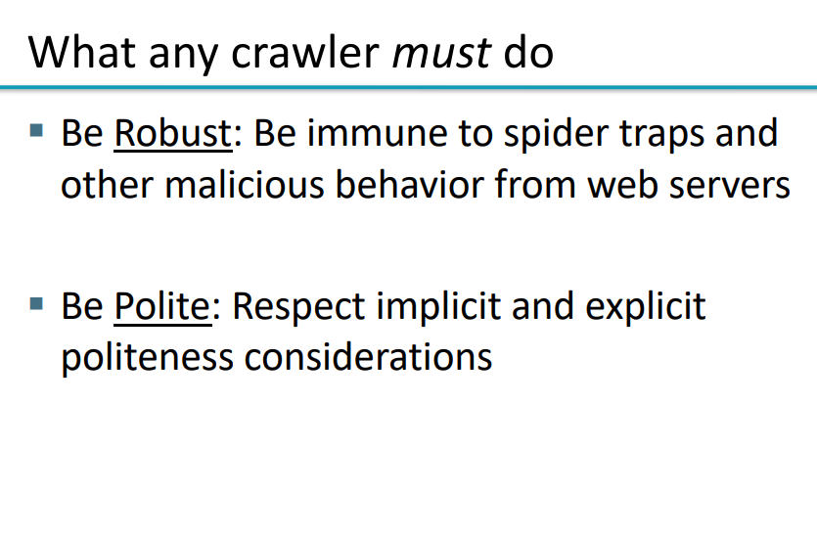

Slide 5
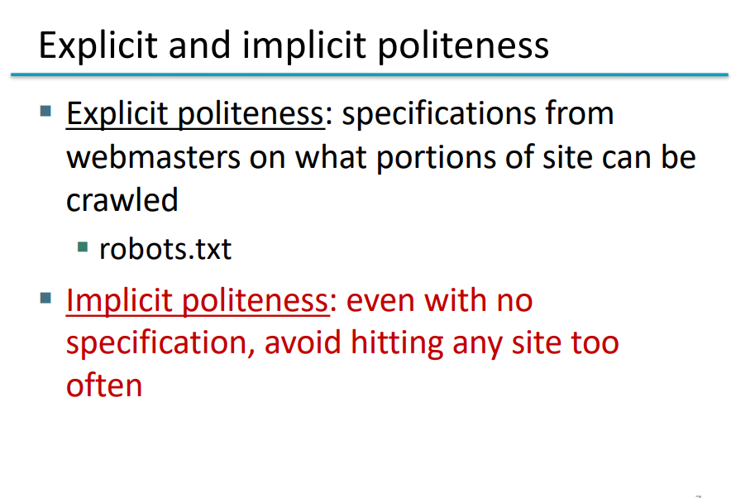

Slide 6
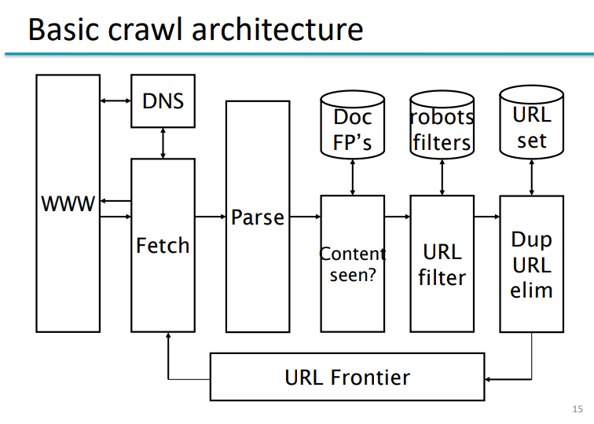

Slide 7
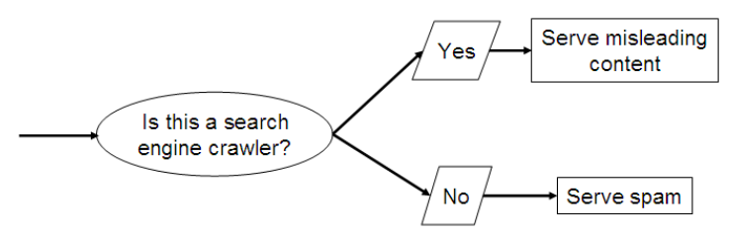
Web Search & User Queries
First generation of Spam: it became clear that web search engines were an important means for connecting advertisers to prospective buyers.
User Query Needs:
Informational queries: seek general information on a broad topic, such as leukemia or Provence. User assimilate information from multiple web pages.
Navigational queries: seek the website or home page of a single entity that the QUERIES user has in mind, say PIA airlines. the best measure of user satisfaction is precision at 1
Transactional query: is one that is a prelude to the user performing a transaction on the Web – such as purchasing a product, downloading a file or making a reservation.

Slide 8
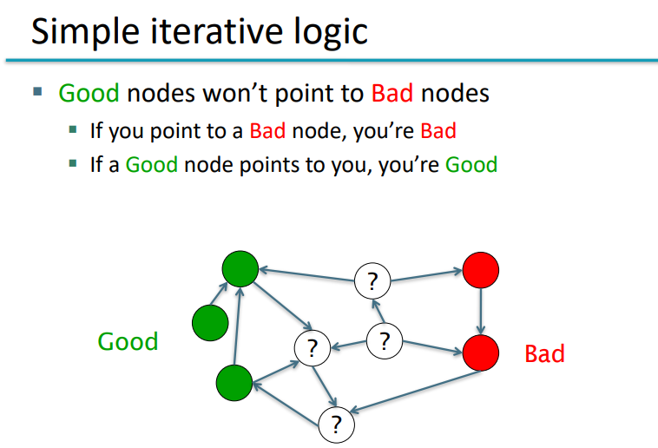

Slide 9
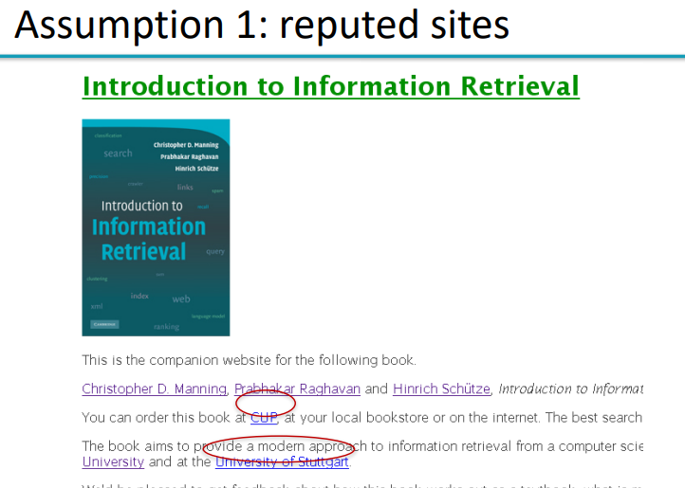
Link Analysis
link analysis builds on two intuitions:
1. The anchor text pointing to page B is a good description of page B.
2. The hyperlink from A to B represents an endorsement of page B, by the creator of page A.

Slide 10
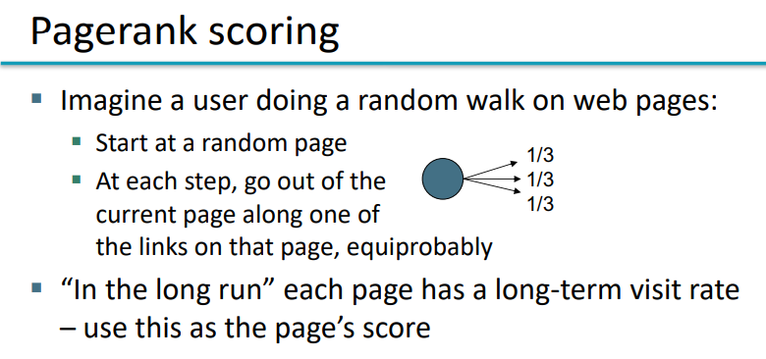
Link Analysis with PageRank

Slide 11
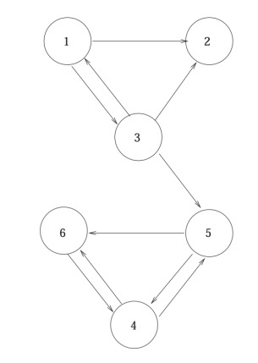
Web Search Graph Representation
Teleport: What if the current location of the surfer, the node A, has no out-link?
In assigning a PageRank score to each node of the web graph:
use the teleport operation in two ways:
When at a node with no out-links, the surfer invokes the teleport operation.
(2) At any node that has outgoing links, the surfer invokes the teleport operation with probability 0 < α < 1 and
the standard random walk (follow an out-link chosen uniformly at random ) with probability 1 − α, where α is a fixed parameter chosen in advance. Typically, α might be 0.1

Slide 12
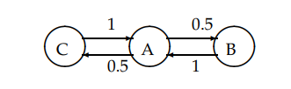
Probability Matrix
A Markov chain’s probability distribution over its states may be viewed as a probability vector: a vector all of whose entries are in the interval [0, 1], and the entries add up to 1

Slide 13
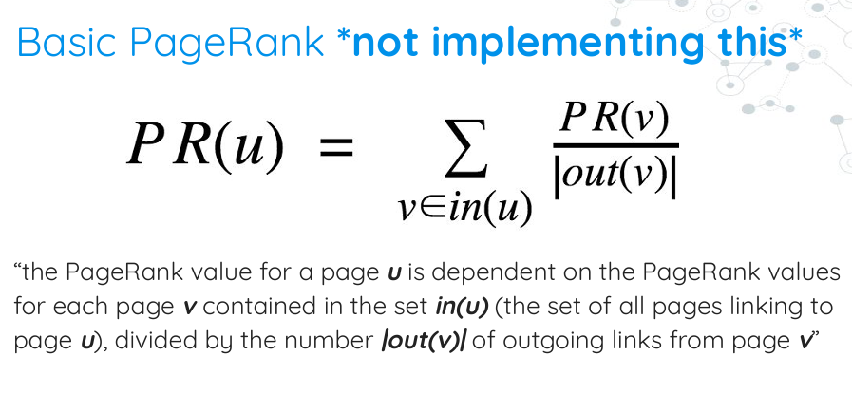

Slide 14
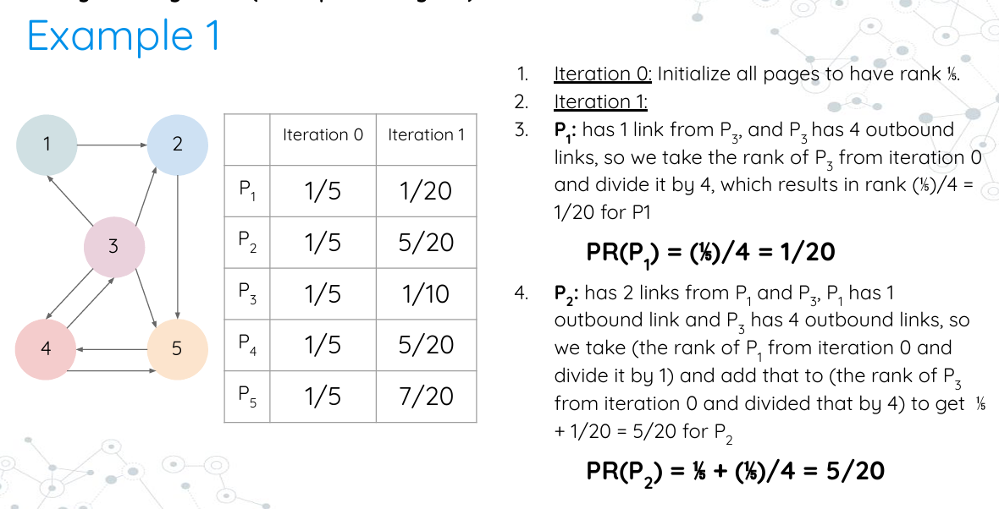

Slide 15
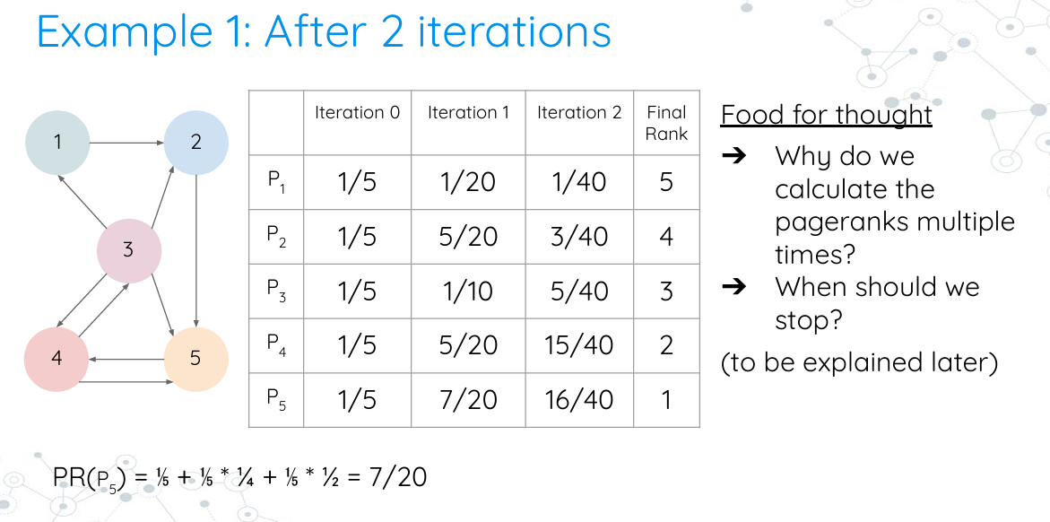

Slide 16
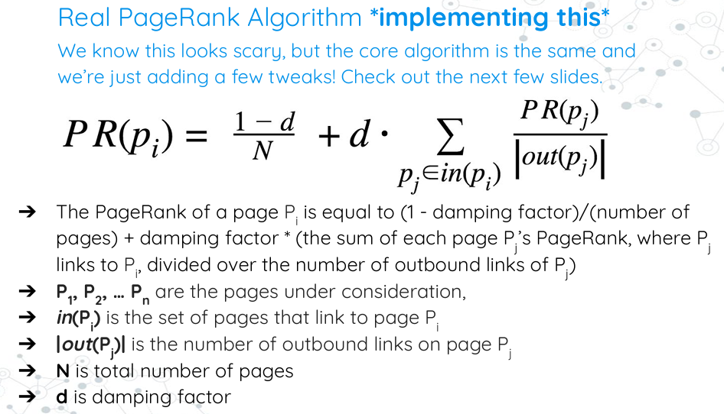

Slide 17
